Slide 1

CG0070 for NMIBC
Phase 3 BOND 3
Phase 2 CORE1
November 2019

Slide 2
Product Pipeline
Compound / Indication | Preclinical | Phase 1 | Phase 2 | Phase 3 | Approved
CG0070 NMIBC - BCG-Unresponsive
CG0070 + KEYTRUDA® NMIBC - BCG-Unresponsive
CG0070 +/ - PD1/PDL1 Muscle Invasive Bladder Cancer (MIBC) Neoadjuvant
CG0070 + Immune Checkpoint Modulator Metastatic Bladder Cancer
CG0070 + Immune Checkpoint Modulator Solid Tumors- Intratumoral Injection
BOND 3
CORE 1
CORE 2
CORE 3
CORE 4

Slide 3
Sum 2020: CG0070 for NMIBC unresponsive to BCG
BOND3 : Phase 3 monotherapy CG0070
  N=110 – global study including North America and Asia / Pacific regions
  Target population: NMIBC: CIS +/- Ta/T1 (plus possible Ta or T1 only pop as well- TBD)
  Q3 start targeted
  Final protocol by end of year
  Schedule/ endpoints- see later in slide deck
  Virus Pk/PD -core virus based assays
  Immune correlates- limit to biopsy in subset
  Shedding- urine, saliva, rectal swab- pre, post dose for initial cycle?
CORE-1: Phase 2 pembrolizumab plus CG0070 for NMIBC
  N= 35-40 - North America only
  Target population: NMIBC: CIS +/- Ta/T1 (no Ta/ T1 only subsets)
  Q2 start targeted
  Final protocol by end of year
  Schedule / endpoints – see later slide in this deck
  Immune correlates on all patients

Slide 4
CG0070: Cancer-selective Oncolytic Adenovirus
Engineered to Preferentially Replicate in Tumor Cells
ITR
pA
E2F-1P
E1A
E3 P
12.5, 6.7
GM-CSF
ADP, RIDa, RIDb, 14.7
Fiber
ITR
E2F Promoter along with GM-CSF transgene inserted into
wild-type adenovirus backbone
Gene / Protein | Function
E2F | Leads to selective viral replication in tumor cells, but not normal cells
E1A | Viral gene retains wild-type adenovirus lytic ability
GM-CSF | GM-CSF activates and matures antigen-presenting cells

Slide 5
Oncolytic Immunotherapy
”Two-pronged” Attack
Targeting and Destroying of Cancer Cells
1
Stimulation of Anti-tumor Immune Response
2

Slide 6
Prior Clinical Data
Approximately 100 NMIBC patients have been treated with CG0070 to date
Mild to moderate toxicity profile, AEs mainly localized to the bladder (e.g. dysuria)
2 Clinical trials completed– Publications completed
  Phase 1 Dose Escalation and Proof of Mechanism: V0046
  Phase 2 Efficacy: BOND 2

Slide 7
Phase 1 Monotherapy Study for NMIBC (V0046)
Anti-bladder Cancer Efficacy Achieved
N = 35, NMIBC CIS or CIS with Ta/T1, and Ta, or T1 Trial Type: Open label
Multi-dose: 1x10¹², 3x10¹², 1x10¹³, 3x10¹³ viral particles
Multi-schedule: Single dose, every 28 days, weekly x 6
Objective: Dose-escalation trial of intravesical CG0070 for superficial transitional cell carcinoma of the bladder after BCG failure
3-month Response
CR by Schedule
CR by Dose
Schedule | CR
Single Dose | 3/13 (23%)
Every 28 Days | 7/13 (54%)
Weekly x 6 | 7/9 (78%)
Multi-Dose (Every 28 days + Weekly x 6) | 14/22 (64%)
Total | 17/35 (49%)
Dose | CR
1 x 10¹² vp | 8/13 (62%)
3 x 10¹² vp | 4/9 (44%)
1 x 10¹³ vp | 5/10 (50%)
3 x 10¹³ vp | 0/3 (0%)
49%
Overall CR
(17/35)
Median Duration: 10.4 months
Burke J, et al. J Urology. 2012.

Slide 8
Phase 1 Monotherapy Study for NMIBC (V0046)
Favorable Safety Profile Achieved
Adverse Event | % Freq.
Dysuria | 71.4
Hematuria | 42.9
Urinary Frequency | 42.9
Urgency | 36.3
Urine Abnormality | 31.4
Bladder Spasm | 28.6
Nocturia | 22.9
Fatigue | 20.0
Arthralgia | 17.1
Bladder Discomfort | 14.3
Abdominal Pain | 14.3
Myalgia | 11.4
Influenza-like Illness | 11.4
Geometric Mean Values of CG0070 Genomes in Urine vs. Time in Single Dose Cohorts
Single Dose
By Day 29, 0% had quantifiable CG0070 genomes in urine; 7.7% (1/13) in plasma
Weekly x 6*
At 29 days after last Rx, 11.1% (1/9) quantifiable in urine and plasma
Every 28 Days*
After last dose, 27.3% (3/11) quantifiable in urine; 7.7% (1/3) in plasma
Most reported AEs were Grade 1 or 2, transient, and none were considered clinically significant; most common was local bladder toxicity
A single Grade 3 event (lymphopenia - related to traumatic catheterization) was reported
* Figure not pictured
Burke J, et al. J Urology. 2012.

Slide 9
Phase 2 Monotherapy Study for NMIBC (BOND2)
Protocol Summary
N = 67, NMIBC CIS or CIS with Ta/T1, and Ta, or T1 Trial Type: Open label
Design: Single-arm, intravesical administration of CG0070
Regimen: Induction course = Weekly x 6 (1x10¹² vp/mL)
Second induction course¹ = Weekly x 6 at month 3 (1x10¹² vp/mL)
Maintenance courses² = Weekly x 6 at month 6 (1x10¹² vp/mL), every 6 months
Primary Endpoint: Durable Complete Response (CR) at 12 months
Study Administration Schedule:
 | Induction | Induction 2 | Maintenance / Follow-Up
Month | 0 | 3 | 6 | 9 | 12 | 15 | 18 | 21
Instillation | 1 2 3 4 5 6 | 1 2 3 4 5 6 | 1 2 3 4 5 6 |  | 1 2 3 4 5 6 |  | 1 2 3 4 5 6
 | Screening Biopsy | Only Non-responders | Mandatory Biopsy |  | Primary Endpoint |  | Last Course
¹ Second induction for non-responders only at month 3; patients receiving second induction do not get treated at month 6
² Maintenance course for complete responders starting at month 6

Slide 10
Phase 2 Monotherapy Study for NMIBC (BOND2)
Positive 6- and 12-month Efficacy
6-month Response
12-month Response
CIS-Containing CR
(21/48)
CIS-Containing CR
(13/45)
44%
29%
37%
Papillary
RFS
(7/19)
32%
Papillary
RFS
(6/19)
Note: 3 patients in the CIS-containing group did not have a 12-month assessment. Preliminary data pending final CSR.

Slide 11
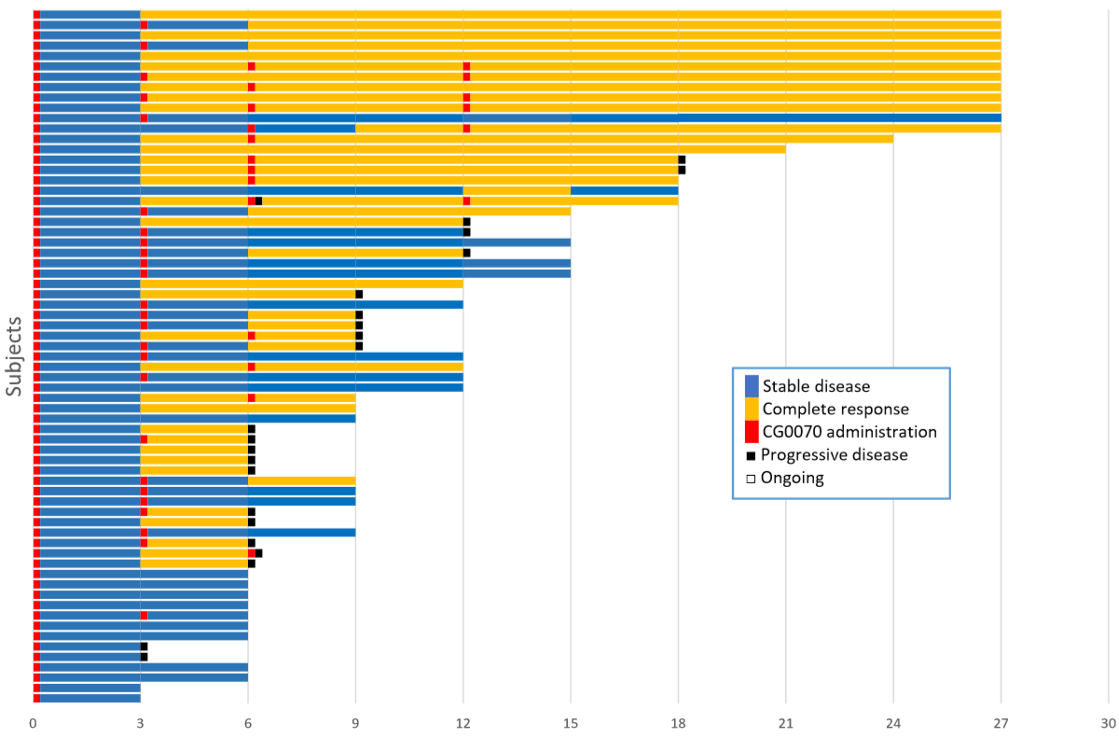
Phase 2 Monotherapy Study for NMIBC (BOND2)
Time on Study, Dose Administered, Response

Slide 12
Phase 2 Monotherapy Study for NMIBC (BOND2)
Second Induction Improves Complete Response Conversion
Follow-on Response Rate After Second Induction of CG0070 at Month 3
 | CR Rate | CIS-Containing | Papillary
Month 3 | 0% CR (0/20) | 17 | 3
Month 6 | 40% CR (8/20) | 7/17 (41%) | 33% (1/3)
Month 9 | 20% (4/20) | 3/17 (18%) | 33% (1/3)
Month 12 | 15% (3/20) | 2/17 (12%) | 33% (1/3)
Second induction at Month 3 was followed by CR conversion at Month 6
Twenty (20) of 67 patients did not achieve a CR at Month 3 and were given a second induction
Eight (8) of these 20 patients converted to CR at Month 6

Slide 13
Phase 2 Monotherapy Study for NMIBC (BOND2)
Favorable Safety Profile Similar to Phase 1 Study
Number of Related AEs by System Organ Class (n=67)
 | Grade 1 | Grade 2 | Grade 3
Renal & Urinary | 37 (12.8%) | 16 (5.5%) | 1 (0.3%)
General & Administration | 6 (2.1%) | 1 (0.3%) | 0 (0.0%)
Gastrointestinal | 2 (0.7%) | 0 (0.0%) | 0 (0.0%)
Infections & Infestations | 4 (1.4%) | 3 (1.0%) | 0 (0.0%)
Nervous System Disorder | 2 (0.7%) | 2 (0.7%) | 0 (0.0%)
Respiratory, Thoracic | 1 (0.3%) | 0 (0.0%) | 1 (0.3%)
Other | 7 (2.4%) | 3 (1.0%) | 0 (0.0%)
Most AEs were Grade 1 or 2, none were considered clinically significant; most common AEs were lower urinary tract symptoms
3 deaths, all unrelated to treatment (cardiac event, esophageal adenocarcinoma, progression to muscle-invasive disease at month 3)
Ninety-one percent (61/67) of patients experienced at least one AE
Two related Grade 3 AEs reported – hypotension and dysuria (both resolved and patient was able to complete treatment course)*
* Neither hypotension nor dysuria were reported as SAEs.

Slide 14
BOND 3 Clinical Trial
Phase 3
Global (50 centers)
N=110- 140
Timelines
FPI: 2H 2020
Enrollment: 18-24 months
LPI: 2H 2022

Slide 15
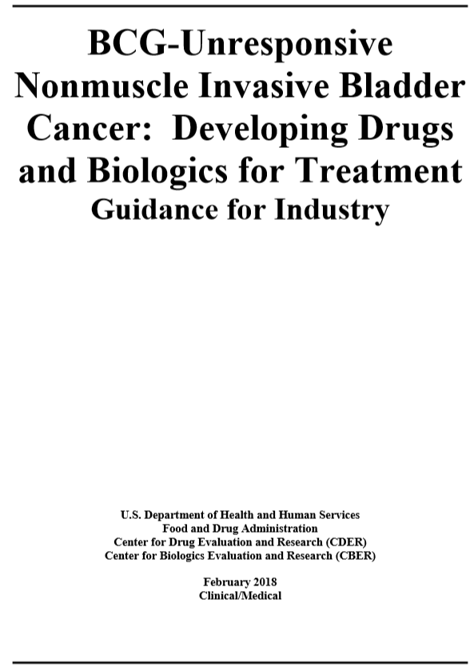
FDA Approval Guidance for BCG Unresponsive NMIBC
Conclusions
FDA guides use of a single arm trial for approval
Clearly defined trial population and entry criteria for BCG-unresponsive NMIBC
FDA position is that no therapy exists for BCG-Unresponsive NMIBC
Approval is based on significant complete response rate and duration of response, along with safety
https://www.fda.gov/downloads/Drugs/GuidanceComplianceRegulatoryInformation/Guidances/UCM529600.pdf

Slide 16
Phase 3 Monotherapy Study for NMIBC (BOND3)
Registrational Study Design for BCG-Unresponsive Disease
N = 110 NMIBC CIS-containing Trial Type: Open label
Design: Single-arm, intravesical administration of CG0070
Regimen: Induction course = Weekly x 6 (1x10¹² vp/mL)
Second induction course¹ = Weekly x 6 at month 3 (1x10¹² vp/mL)
Maintenance courses² = Weekly x 3 at month 3 (1x10¹² vp/mL)
Primary Endpoint: Complete Response (CR) at 12 months
Entry Criteria: BCG Unresponsive NMIBC
Study Administration Schedule:
 | Induction | Induction 2 | Maintenance / Follow-Up
Month | 0 | 3 | 6 | 9 | 12 | 15 | 18 | 21
Instillation | 1 2 3 4 5 6 | 1 2 3 4 5 6 | 1 2 3 | 1 2 3 | 1 2 3 |  | 1 2 3
 | Screening Biopsy | Only Non-responders | Mandatory Biopsy |  | Primary Endpoint |  | Last Course
¹ Second induction for non-responders is weekly x 6.
² Maintenance course for complete responders (month 3) is every 3 months for 1st year, and every 6 months for 2nd year.

Slide 17
Phase 3 BOND3 key study endpoints
1. Primary
  Complete response rate at 12 months
2. Secondary
  Safety of CG0070 using CTCAE version 5.0
  Complete response rate at anytime on study
  Complete response rate at 3, 6, 18, and 24 months
  Duration of complete response (CR)
  Time to cystectomy
  Time to progression
  Disease-specific survival
  Overall survival (OS)

Slide 18
Phase 3 BOND3 study endpoints
3. Exploratory
Evaluate anti-tumor and anti-viral immune response including assessment of immune response in the peripheral blood and tumor microenvironment to include PDL-1 and T‑cell infiltration and activation level
Evaluate tumor E2F gene expression in tumor biopsy
Evaluate changes in the blood and urine cytokine profile
Evaluate urine, blood, and tissue levels of CG0070

Slide 19
Phase 3 BOND3 Key Entry Criteria
Inclusion Criteria:
Eastern Cooperative Oncology Group (ECOG) performance status 0 to 1
Pathologically confirmed NMIBC with CIS (with or without Ta/T1 disease)
Unresponsive to prior BCG therapy (Lerner 2015) defined as: persistent or recurrent CIS alone or with recurrent Ta/T1 (noninvasive papillary disease/tumor invades the sub-epithelial connective tissue) disease within 12 months of completion of adequate BCG therapy.
  ---An assessment within 15 months can also qualify when no assessment was performed within 12 months after completion of adequate BCG therapy.
  ---Adequate BCG is defined as at least 5 treatments with induction BCG followed by at least 2 BCG treatments as reinduction or maintenance
Ineligible for radical cystectomy or refusal of radical cystectomy
Adequate organ function

Slide 20
Phase 3 BOND3 Study Eligibility
Exclusion Criteria:
1. Immuno-deficient due to chronic steroid or other immunosuppressant use, HIV, or prior organ transplant
Prior treatment with adenovirus-based cancer therapy
Clinically significant or active cardiac disease
Active autoimmune disease

Slide 21
Core 1
Phase 2 Combination with Pembrolizumab
N=32-38 (15 Centers)
Timelines
FPI: 1H 2020
Enrollment: 12 months
LPI: 1H 2021

Slide 22

Phase 2 Combination Rationale with Anti-PD1
Both Drugs Exhibit Strong Single-agent Activity in BCG-Unresponsive NMIBC
 | CG0070 | KEYTRUDA
3-month Efficacy* | 46% CR (22/48) [CI: 32%-61%] | 39% CR (40/103) [CI: 29%-49%]
Efficacy Endpoint | 12-month Complete Response rate | Complete Response rate
Stage | Phase 3-ready | Phase 2-ongoing
Description | Oncolytic virus | Immune checkpoint inhibitor (PD-1)
 | Partnership Completed with Merck in 2018 CG0070 + KEYTRUDA combo study initiates 2020
* Efficacy comparison for CIS-containing disease stage
References: Merck (Balar, et al. 2019)
Note: Statistical test based on 95% confidence interval including continuity correction

Slide 23
CORE-001 Protocol Design
Phase 2 CG0070 and Pembrolizumab combination study
Study Design for NMIBC BCG-Unresponsive Disease
N = 33 NMIBC CIS-containing Trial Type: Single-arm
Design: Single-arm, intravesical administration of CG0070 plus intravenous administration of Pembrolizumab
CG0070 Regimen: Induction courses = Weekly x 6 (1x10¹² vp/mL)
Second induction course¹ = Weekly x 6 at month 3 (1x10¹² vp/mL)
Maintenance courses² = Weekly x 3 (1x10¹² vp/mL)
First year regimen is every 3 months. Second year regimen is every 6 months.
Keytruda Regimen: Pembrolizumab Every 3 Weeks (200mg)
Primary Endpoint: 12 mos CR rate
Study Administration Schedule
Baseline and on treatment biopsies at day 10 or 20 (TBD)
¹ Second induction for non-responders at month 3.
² Maintenance course for complete responders starting at month 3.
Notes:
BCG Unresponsive Definition: (at least one of the following)
Persistent or recurrent CIS alone or with recurrent Ta/T1 (noninvasive papillary disease/tumor invades the subepithelial connective tissue) disease within 12 months of completion of adequate BCG therapy
Recurrent high-grade Ta/T1 disease within 6 months of completion of adequate BCG therapy
T1 high-grade disease at the first evaluation following an induction BCG course (Steinberg et al 2016)
Adequate BCG therapy: (at least one of the following)
At least five of six doses of an initial induction course plus at least two of three doses of maintenance therapy
At least give of six doses of an initial induction course plus at least two of six doses of a second induction courses

Slide 24
Phase 2 CORE-001 study endpoints
1. Primary
  Complete response rate at 12 months
2. Secondary
  Safety of CG0070 and pembrolizumab (AEs) comparing incidence, severity and relationship using CTCAE version 5.0
  Complete response rate at anytime on study
  Complete response rate at 3, 6, 18, and 24 months
  Duration of complete response (CR)
  Time to cystectomy
  Time to progression
  Disease-specific survival
  Overall survival (OS)

Slide 25
Phase 2 CORE-001 study endpoints
3. Exploratory
Evaluate anti-tumor and anti-viral immune response including assessment of immune response in the peripheral blood and tumor microenvironment to include PDL-1 and T‑cell infiltration and activation level
Evaluate tumor E2F gene expression in tumor biopsy
Evaluate changes in the blood and urine cytokine profile
Evaluate urine, blood, and tissue levels of CG0070

Slide 26
Phase 2 CORE-001 Key Entry Criteria
Inclusion Criteria:
Eastern Cooperative Oncology Group (ECOG) performance status 0 to 1
Pathologically confirmed NMIBC with CIS (with or without Ta/T1 disease)
Unresponsive to prior BCG therapy (Lerner 2015) defined as: persistent or recurrent CIS alone or with recurrent Ta/T1 (noninvasive papillary disease/tumor invades the sub-epithelial connective tissue) disease within 12 months of completion of adequate BCG therapy. An assessment within 15 months can also qualify when no assessment was performed within 12 months after completion of adequate BCG therapy.
  ---Adequate BCG is defined as at least 5 treatments with induction BCG followed by at least 2 BCG treatments as reinduction or maintenance
Ineligible for radical cystectomy or refusal of radical cystectomy
Adequate organ function

Slide 27
Phase 2 CORE-001 Study Eligibility
Exclusion Criteria:
1. Immuno-deficient due to chronic steroid or other immunosuppressant use, HIV, or prior organ transplant
Prior treatment with adenovirus-based cancer therapy
Prior therapy with or intolerant to prior checkpoint inhibitor therapy
Clinically significant or active cardiac disease
Active autoimmune disease

